Slide 1


Department of Computer Science and Engineering
GE19612 – PRIEE
FITNESS WEBSITE WITH CHATBOT
Kaarokki R-210701101
Harinisubashree S-210701072
Harini Praba M-210701069

Slide 2
Problem Statement and Motivation
Many individuals struggle to achieve their fitness goals due to a lack of personalized guidance in diet and exercise. Generic fitness plans fail to account for individual differences in dietary preferences, fitness levels, and health objectives, leading to poor adherence and suboptimal results.
Additionally, users often find it challenging to track their progress effectively and stay motivated.
There is a need for a comprehensive solution that provides personalized diet plans, tailored workout routines, and accurate BMI calculations, all facilitated by an interactive chatbot that offers real-time support and motivation, enhancing user engagement and success in achieving fitness goals.

Slide 3
Objectives
The aim of the Fitness Analyzer using chatbot technology is to provide users with an accessible and personalized platform for health and fitness monitoring
By leveraging chatbot capabilities, this innovative tool aims to offer tailored guidance, track progress, and provide actionable insights to help individuals achieve their wellness goals.
The Fitness Analyzer using chatbot technology aims to revolutionize the way individuals approach health and fitness by providing a comprehensive platform for personalized health monitoring, goal setting, and support.

Slide 4
Abstract
This project introduces a comprehensive fitness analyzer with an intelligent chatbot interface, designed to empower users in achieving their health and wellness goals.
The website integrates personalized diet plans, tailored workout routines, and precise Body Mass Index (BMI) calculations to provide a holistic approach to fitness.
The chatbot serves as an interactive guide, assisting users in navigating the platform and offering real-time advice and support. This feature helps users understand their body composition and set realistic goals.

Slide 5
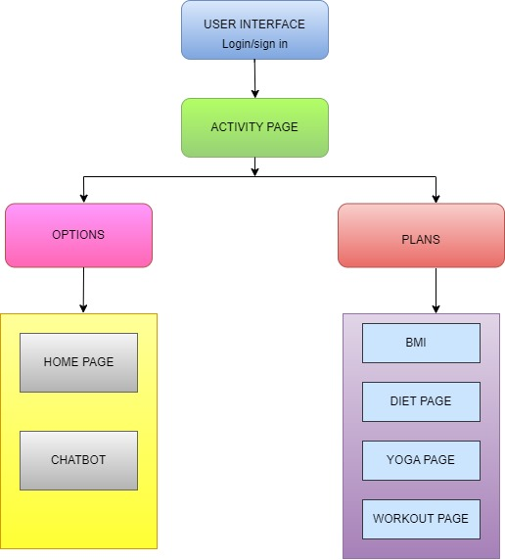
System Architecture
This diagram outlines the structure of a user interface for a wellness application. Users start by logging in or signing up, leading to the Activity Page.
From there, they can navigate to the Options section, which includes the Home Page and a Chatbot.
Alternatively, they can access the Plans section, which contains pages for BMI, Diet, Yoga, and Workouts.

Slide 6
List of Modules
USER MODULE:
The user module of a fitness website includes login/sign-up for personalized access, an Activity Page featuring navigation options, and a Chatbot for assistance. Users can calculate their BMI, access tailored diet plans, yoga routines, and workout programs. The Home Page provides an overview of available features, ensuring a seamless experience in managing fitness goals and receiving customized advice through interactive tools.

Slide 7
List of Modules
CHATBOT MODULE:
The chatbot module on the fitness website assists users with various tasks. It provides instant responses to fitness and wellness queries, guides users through BMI calculations, and offers tailored advice on diet plans, yoga routines, and workouts. The chatbot is integrated into the Home Page for easy access, enhancing user engagement by providing personalized support, reminders, and motivation. It ensures a user-friendly experience by simplifying navigation and offering real-time assistance.
BMI MODULE:
The BMI module on the fitness website allows users to calculate their Body Mass Index by entering their height and weight. It provides instant results and interprets the BMI value to categorize users into different health ranges (underweight, normal, overweight, obese). This module also offers personalized recommendations for diet and exercise plans based on the BMI results, helping users set and achieve their fitness goals. It's accessible through the Plans section for easy navigation.

Slide 8
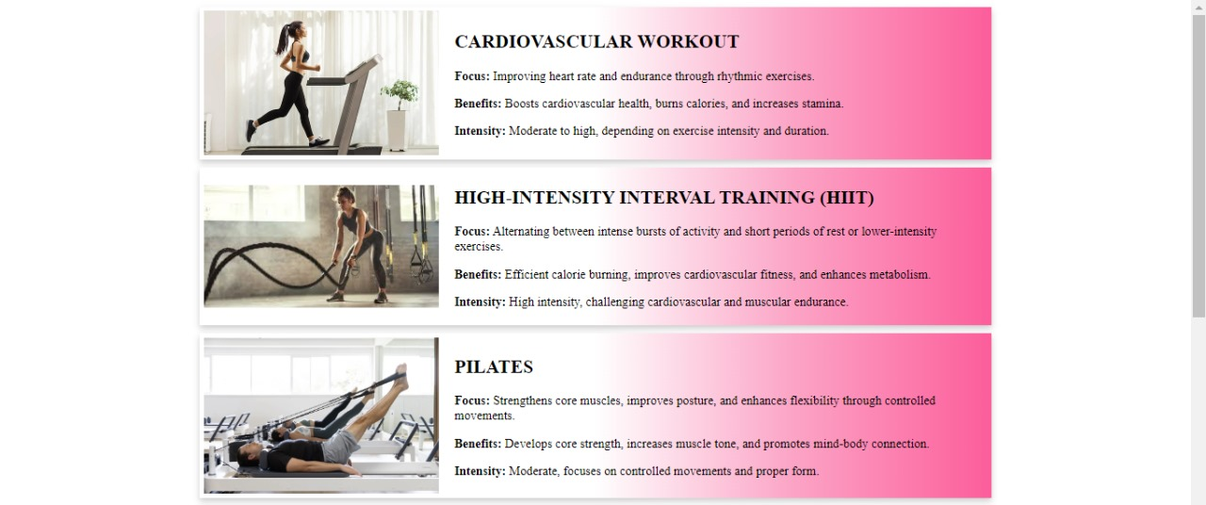
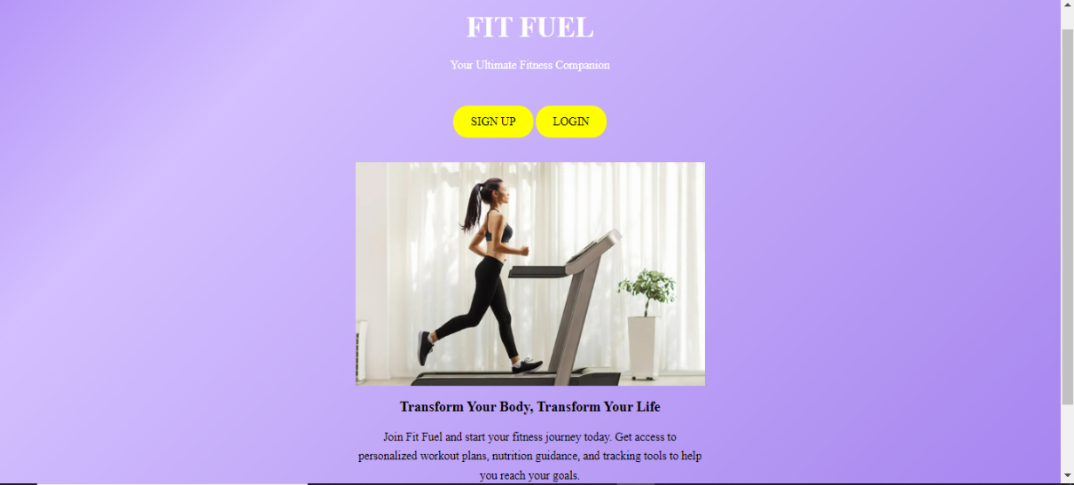
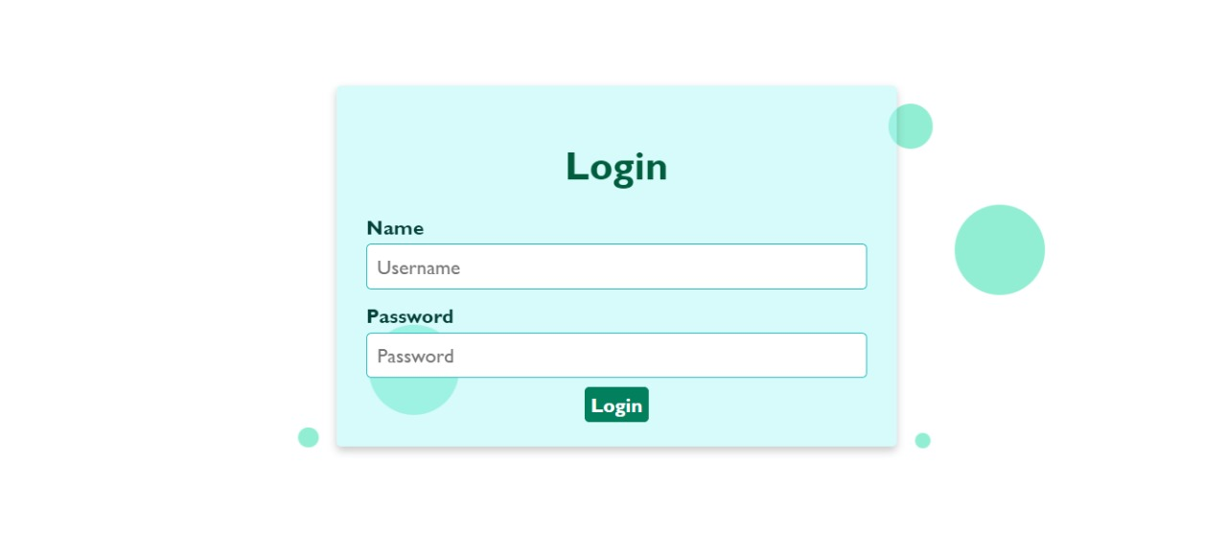
Implementation/Results of Module

Slide 9
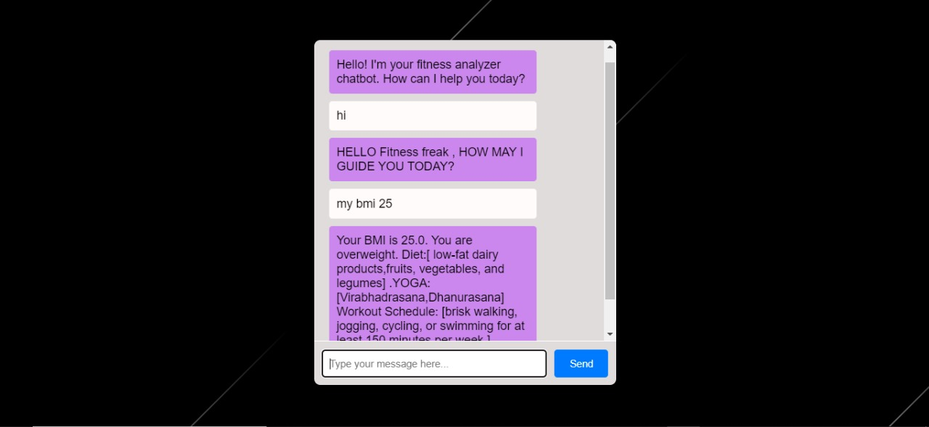
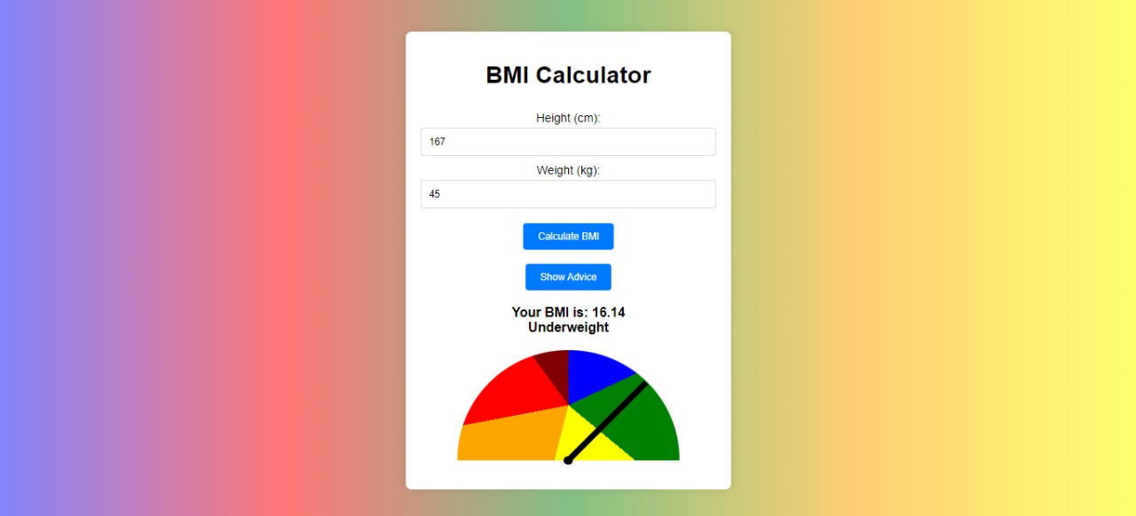
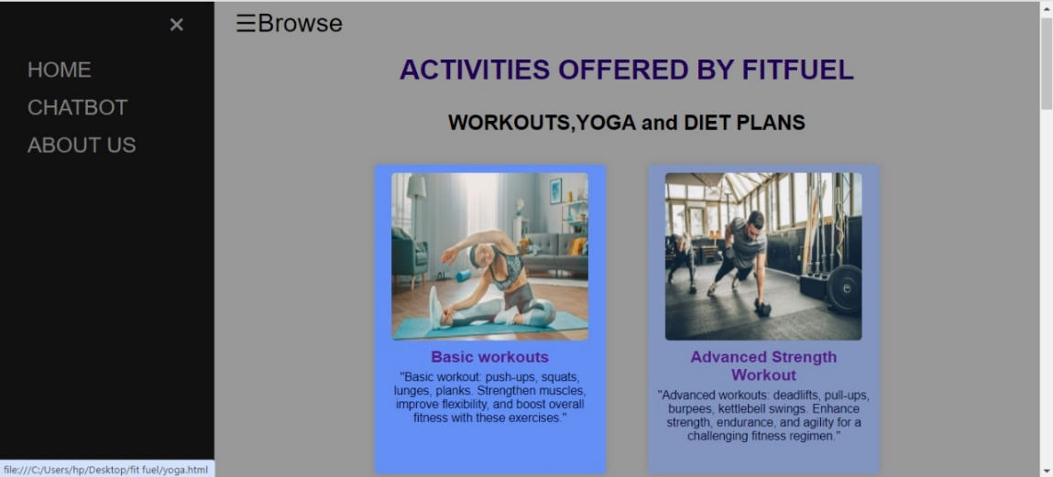
Implementation/Results of Module

Slide 10
Implementation/Results of Module
The result of developing the fitness website, utilizing HTML, CSS, and JavaScript, is a robust and user-centric platform that effectively meets its intended goals and enhances user engagement in health and fitness management. The website provides comprehensive features including personalized diet plans, workout schedules, BMI calculations, and interactive chatbot functionality. The chatbot, developed using JavaScript functions, provided personalized recommendations and support, further enhancing user engagement and satisfaction. Its ability to learn from user interactions allows it to continuously improve responses and adapt to user preferences over time.

Slide 11
Conclusion
In conclusion, the development of the fitness website represents a culmination of efforts aimed at creating a comprehensive and user-centric platform for health and fitness management.
The Utilizing HTML, CSS, and JavaScript, the project successfully delivered a responsive and visually appealing frontend interface that ensures accessibility and engagement across various devices.
The Delivery Person module coordinates the logistics of picking up and delivering the donations, displaying the pickup and drop-off locations to ensure timely and accurate distribution.

Slide 12
References
[1] Miklosik, A., Evans, N., & Qureshi, A. M. A. (2021). The use of chatbots in
digital business transformation: A systematic literature review. IEEE Access,
9, 106530-106539.
[2] Abdullah, A., & Alhamid, M. F. (2020). Chatbots in
healthcare: State-of-the-art review of the literature. Healthcare
Informatics Research, 26(2), 146-160
[3] A. E. Vadillo, et al., "Effectiveness of Chatbots in the Healthcare Domain:
A Systematic Mapping Study," in Proceedings of the 27th International .
Conference on Computers in Education, 2019, pp. 144-153.
[4] S. W. Radermacher, et al., "Understanding the Role of Chatbots:
Health and Well-Being: A Scoping Review," International Journal of Environmental
Research and Public Health, vol. 17, no. 11, pp. 1-23, 2020

Slide 13
Github Link
Github Link: https://github.com/Kaarokki/GE19612-PRIEE-101-072-069

Slide 14
Thank You

